Slide 1
Lecture Tow Chapter 2 METAL CASTING PROCESSES
Sand Casting
Other Expendable Mold Casting Processes
Permanent Mold Casting Processes
Foundry Practice
Casting Quality
Metals for Casting
Product Design Considerations

Slide 2
Two Categories of Casting Processes
Expendable mold processes - mold is sacrificed to remove part
Advantage: more complex shapes possible
Disadvantage: production rates often limited by the time to make mold rather than casting itself
Permanent mold processes - mold is made of metal and can be used to make many castings
Advantage: higher production rates
Disadvantage: geometries are limited by the need to open the mold

Slide 3
Overview of Sand Casting
Most widely used casting process, accounting for a significant majority of total tonnage cast
Nearly all alloys can be sand casted, including metals with high melting temperatures, such as steel, nickel, and titanium
Castings range in size from small to very large
Production quantities from one to millions

Slide 4
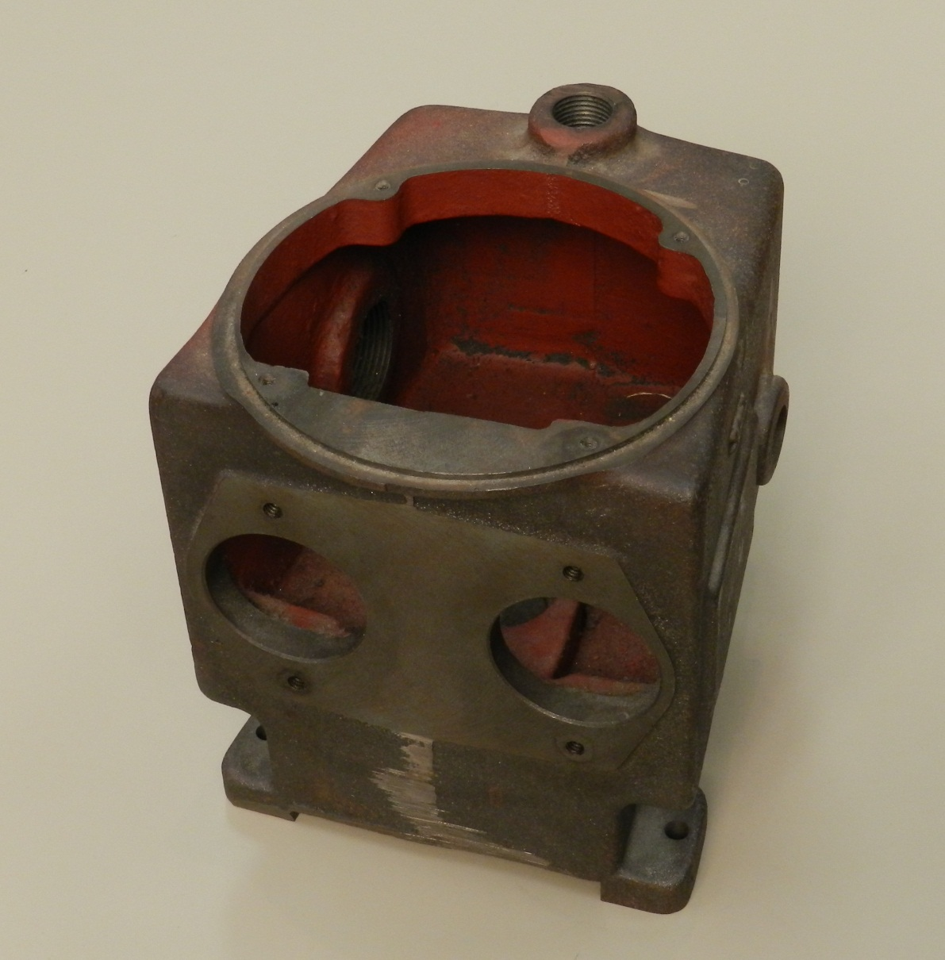
Sand casting for an industrial pump. Holes and surfaces have been machined (courtesy of George E. Kane Manufacturing Technology Laboratory, Lehigh University)

Slide 5
Steps in Sand Casting
Pour the molten metal into sand mold
Allow time for metal to solidify
Break up the mold to remove casting
Clean and inspect casting
Separate gating and riser system
Heat treatment of casting is sometimes required to improve metallurgical properties

Slide 6
Making the Sand Mold
The cavity in the sand mold is formed by packing sand around a pattern, then separating the mold into two halves and removing the pattern
The mold must also contain gating and riser system
If casting is to have internal surfaces, a core must be included in mold
A new sand mold must be made for each part produced

Slide 7
Sand Casting Production Sequence
Production sequence in sand casting, including pattern‑making and mold‑making

Slide 8
The Pattern
Full‑sized model of the part, slightly enlarged to account for shrinkage and machining allowances in the casting
Pattern materials:
Wood - common material because it is easy to work, but it warps
Metal - more expensive to fabricate, but lasts longer
Plastic - compromise between wood and metal

Slide 9
Types of Patterns
Types of patterns used in sand casting: (a) solid pattern, (b) split pattern, (c) match‑plate pattern, (d) cope and drag pattern

Slide 10
Core
Full‑scale model of interior surfaces of part
Inserted into mold cavity prior to pouring
The molten metal flows and solidifies between the mold cavity and the core to form the casting's external and internal surfaces
May require supports to hold it in position in the mold cavity during pouring, called chaplets

Slide 11
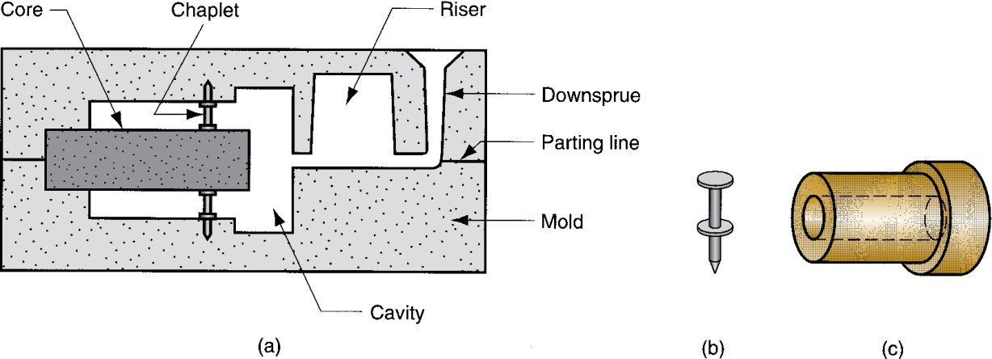
Core in Mold
(a) Core held in place in the mold cavity by chaplets, (b) possible chaplet design, (c) casting

